Slide 1
Recurrent Neural Networks (RNNs) part ii
COMP 4230
David J Stucki
Fall 2024

Slide 2
Alerts
Questions?
Read Moroney Chapter 7 (still)
Read Larson Chapter 13 & 14

Slide 3
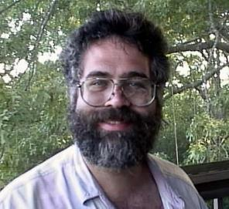
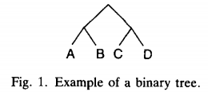
Early Applications of RNNs: RAAM
“A longstanding difficulty for connectionist modeling has been how to represent variable-sized recursive data structures,
such as trees and lists, in fixed-width patterns.”
—Jordan Pollack (Recursive Distributed Representations, 1990)—
Recursive Auto-Associative Memory (RAAM)
  In a nutshell, a mechanism for compressing binary trees down to a fixed size representation
  Suppose we have the binary tree pictured here:
  If we let the subtree consisting of A & B be called R1 and the subtree consisting of C & D be called R2, then the tree which has R1 and R2 as its left and right subtrees could be called R3
  The symbol R3 is a compact representation of the entire tree!

Slide 4
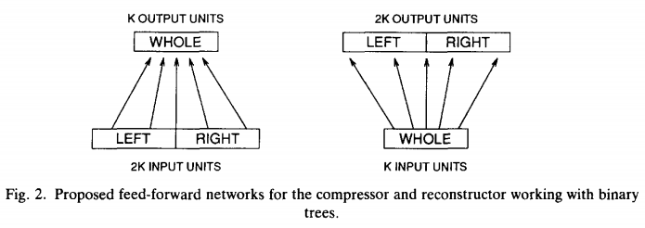
Early Applications of RNNs: RAAM
Recursive Auto-Associative Memory (RAAM)
  In order to accomplish this with a neural network, requires that we be able to compress and then reconstruct our representations:
  Conveniently, this can be done by training the network to do both at the same time with a feedforward, auto-associative model that learns its own representations for the compressed layer.

Slide 5
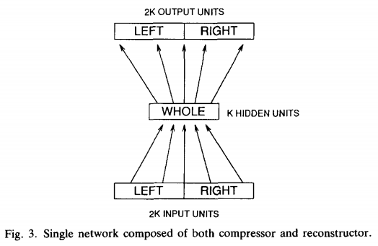
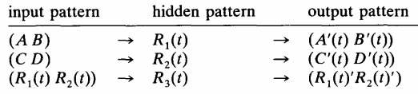
Early Applications of RNNs: RAAM
Recursive Auto-Associative Memory (RAAM)
  This architecture becomes a recurrent network when the process is applied recursively for deeper trees
  A variation of this architecture was also used to compress stacks

Slide 6
Early Applications of RNNs: Sequential Cascaded Networks (SCNs)
“How could a neural computational system, with its slowly-changing
structure, numeric calculations, and iterative processes, ever come to
possess linguistic generative capacity, which seems to require dynamic representations, symbolic computation, and recursive processes?”
—Jordan Pollack (The Induction of Dynamical Recognizers, 1991)—
In other words, can a recurrent neural network be trained to perform the function of a finite state automata?
Can a recurrent backpropagation algorithm be a language inducer?
  Wait, is there a version of back-propagation for recurrent networks?

Slide 7
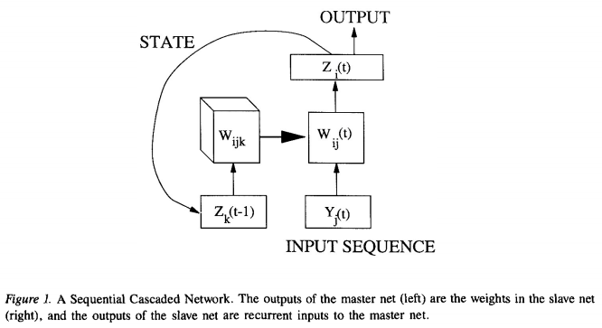
Sequential Cascaded Networks
Each output serves as a selector for which set of weights will be used to process the next round of input values.
The matrix W serves as a set of
rules, or transformations, that
are picked dynamically for each
input
Training requires the recurrent
loop to be unrolled one step

Slide 8
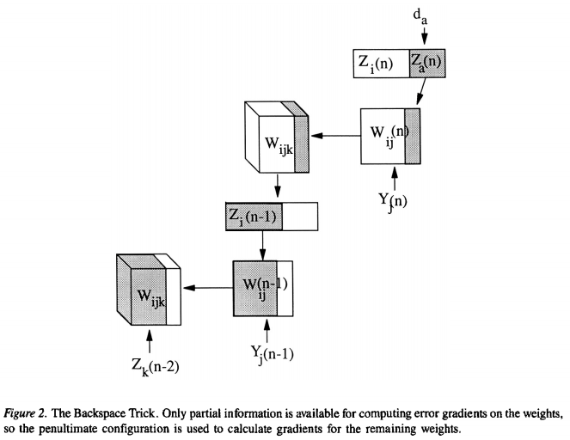
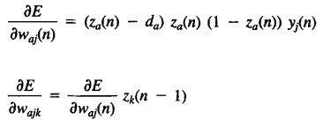
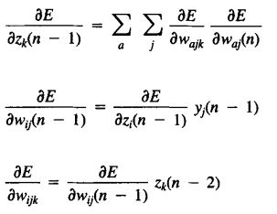
Sequential Cascaded Networks
The math here can get a bit messy...

Slide 9
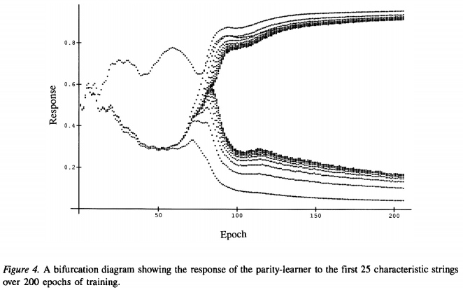
Sequential Cascaded Networks
When training a network to learn parity (accept strings with an odd number of 1's)
At epoch 85 it undergoes a 'phase transition' and suddenly has solved the general problem.

Slide 10
Early Applications of RNNs: Sequential Cascaded Networks (SCNs)
Pollack's conclusion:
“The state-space limit of a dynamical recognizer, as Σ* → Σ∞, is an Attractor,
which is cut by a threshold (or similar decision) function. The complexity of the generated language is regular if the cut falls between disjoint limit points or cycles, context free if it cuts a "self-similar" (recursive) region, and context-sensitive if it cuts a "chaotic" (pseudo-random) region.”
—Jordan Pollack (The Induction of Dynamical Recognizers, 1991)—

